Slide 1

Ear biometric system for secure online payment
Under guidance of
Ms.P.Sowmya,
Designation,
BIT, Sathy.
JAYASHREE R (201SE118)
MAHALAKAME RM (201SE126)

Slide 2
AGENDA
01
02
03
04
05
06
07
ABSTRACT
EXISTING SYSTEM
PROPOSED SYSTEM
ARCHITECTURE
RESULTS & DISCUSSION
CONCLUSION
REFERENCES

Slide 3
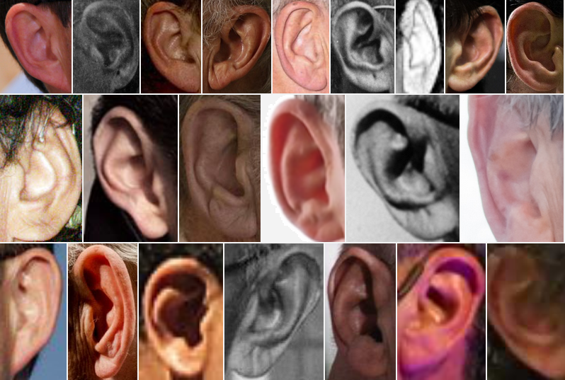
ABSTRACT
With the rising digitalization of services, we have witnessed the introduction of numerous payment and information exchange mechanisms. NFC, credit/debit card, and QR code-based payment mechanisms have grown quite popular. These strategies were designed to make transactions more secure, safe, and speedier. Although they have been successful to some level, there are a number of issues that are causing problems such as confusion, time consumption, security threats, fraud, and theft.
The proposed framework of the biometric system based on the ear is provided using CNN.

Slide 4
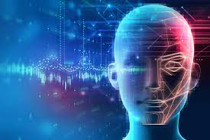
EXISTING SYSTEM:
In two-step verification,
The first step is OTP verification followed by facial recognition.
The system uses an online interface in order to interact with a
user. The interface is used to get card details from the
particular user. After the OTP verification, the user will be
authenticated using facial recognition. A deep neural network-based face image recognition is suggested, and a convolutional neural network is employed to extract facial characteristics.
The system uses a CNN in order to verify the user by comparing the real time captured
image of the user against the images associated with the users
account.

Slide 5
PROPOSED SYSTEM
In recent years, there has been a lot of interest in the process of precisely recognizing persons by their ears. It is a significant step forward in biometric research, particularly as a supplement to facial recognition algorithms, which have difficulty in real-world scenarios. This is due to the wide range of shapes, changing lighting circumstances, and shifting profile shape, which is a planar depiction of a complicated entity. To identify a person given an input image, an ear recognition system based on convolutional neural networks (CNN) is developed. When tested against clean images, the proposed method equals the performance of existing traditional approaches.

Slide 6
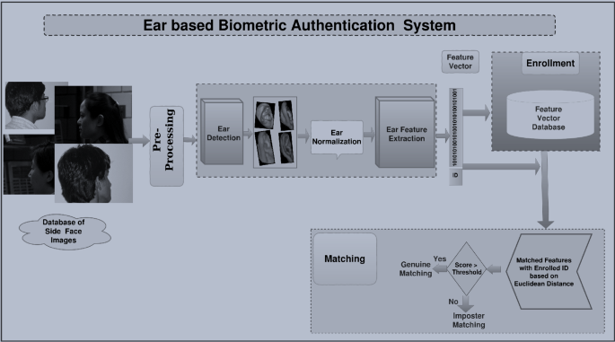
STEPS INVOLVED

Slide 7
RESULTS:
This study was designed to determine whether it is possible to employ deep neural networks in the recognition of persons by their ears through photographs. The average of the confusion matrix for the data training and testing is encouraging in preliminary results. On the AWE dataset, the best ear detection gets an IoU score of 96.13 percent.

Slide 8
CONCLUSION
We investigated the problem of training CNN-based models for ear recognition with limited training data in this paper. By successfully recognising and authenticating authorised users, the system improves the security of online transactions.Any application that requires online payments can use the system as a payment gateway. Ecommerce websites, internet banking, and mobile banking are examples of these. The system is accessible via any web browser on any operating system. In the future, iris identification could be added to the system to improve transaction security.

Slide 9
REFERENCES
Multi-view face recognition using deep neural networks
Face Recognition for Payment and Information Sharing [J]
Multimodal biometric cryptosystem for human authentication using fingerprint and ear
Deep arm/ear-ECG image learning for highly wearable biometric human identification
A comprehensive survey and deep learning-based approach for human recognition using ear biometric
Can convolution neural network (CNN) triumph in ear recognition of uniform illumination invariant?
Notes:
You can safely remove this slide. This slide design was provided by SlideModel.com – You can download more templates, shapes and elements for PowerPoint from http://slidemodel.com

